Slide 1
Linear Programming using Python and its application in fair room allocation
Under the guidance of Prof. Swaprava Nath
Submitted by Santosh Kavhar

Slide 2



Problem
Same rent for every room?
Room 1
Room 3
Room 2

Slide 3
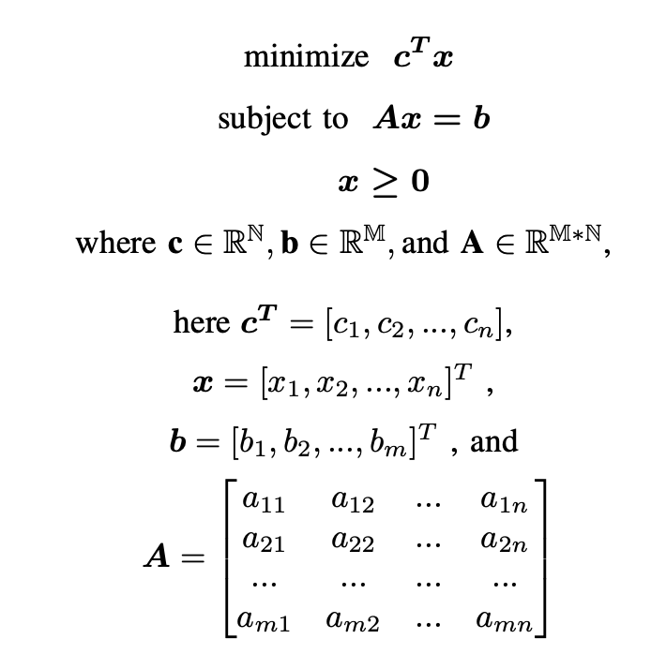
What is LP?
Linear Objective
and Linear inequalities
A method of optimising
operations with some constraints

Slide 4
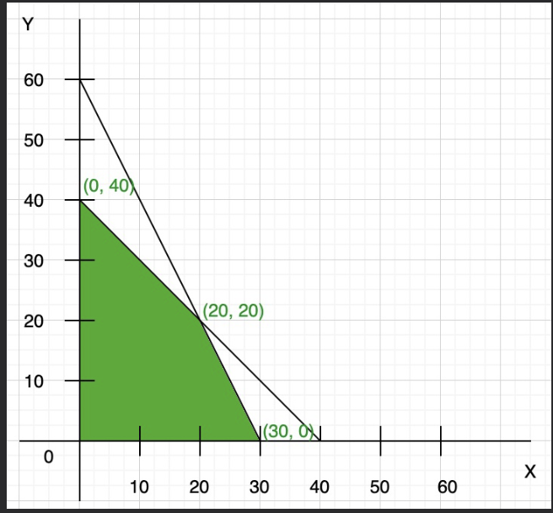
Example
Maximize: Z = 7x + y
Constraints:
x + y <= 40,
2x + y <= 60,
x >= 0, y >= 0
Max at (30, 0) -> Optimal value 210

Slide 5


What is Python?
Interpreted and interesting language
Support for PuLP

Slide 6
Motivation
Why this problem?
Real world
Why LP?
Used in the implementation paper
Easy and efficient
Why Python?
Strong community
Support of PuLP

Slide 7
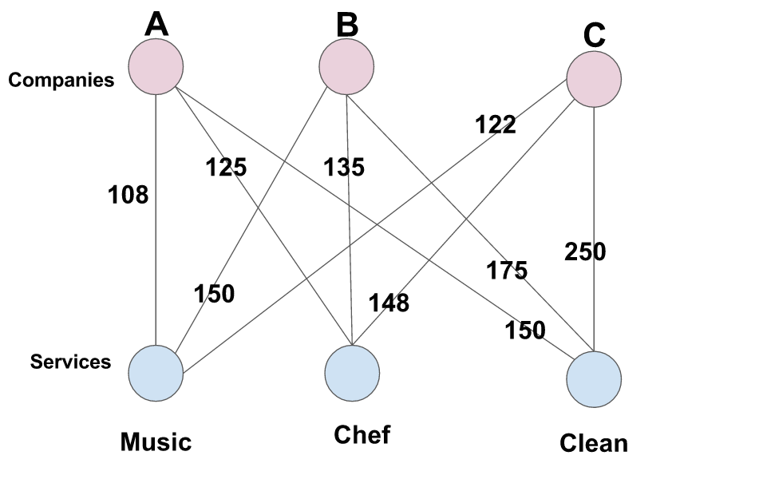
Maximum Welfare assignment
-aka Maximum Weight Bipartite Matching

Slide 8
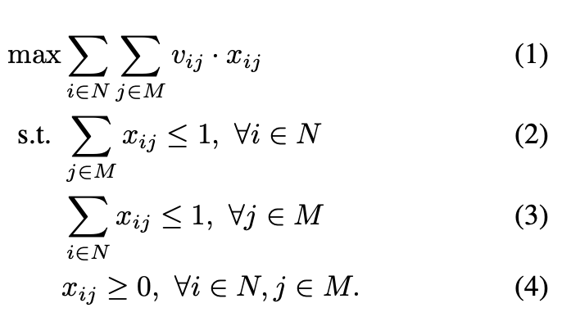
It’s Formulation

Slide 9
Example
Maximum welfare assignment or MWBM
Rent per Room\ Renter | Alice | Bob | Cathy
Room 1 | 300 | 400 | 250
Room 2 | 300 | 200 | 250
Room 3 | 400 | 400 | 500

Slide 10

Envy-freeness
The profit or utility is equal for
all the players.

Slide 11
PuLP
Variable -> x1 = LpVariable("x1", 0, None, LpInteger)
Problem -> problem = LpProblem("RoomAllocation", LpMaximize)
Optimization -> problem += 6* x1 + 4 * x2 + 7 * x3 + 5 * x4
Solve -> solve() method

Slide 12
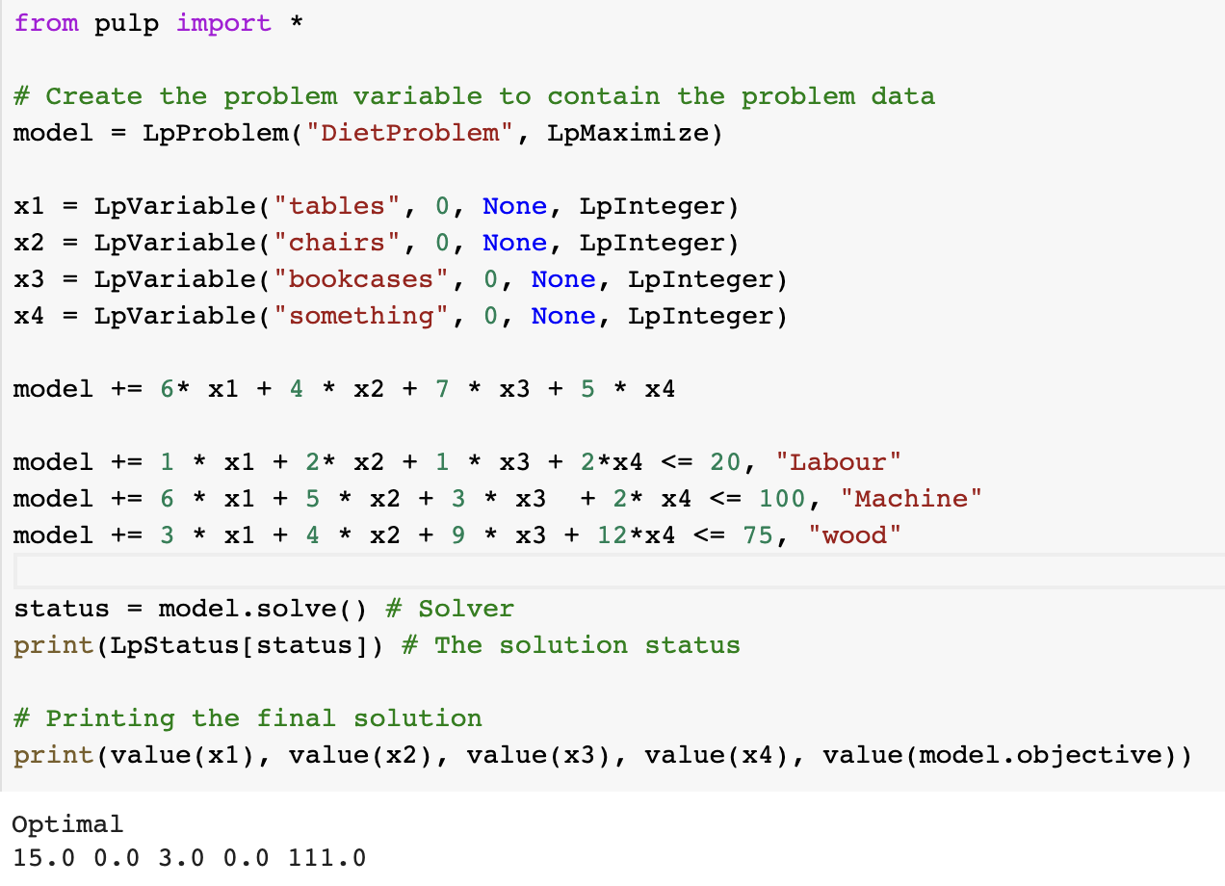
PuLP Implementation

Slide 13
Conclusions
LP to do the fair house allocation with help of PuLP library in python.
First step is to do maximum welfare assignment
Second is to ensure envy-freeness

Slide 14
Future Scope
Improve the python code as per suggestions from guide
Envy-freeness using python and PuLP
Implement spliddit like application

Slide 15
THANK YOU!!

Slide 16
References
Edwin KP Chong and Stanislaw H Zak. An introduction to optimization, volume 75. John Wiley & Sons, 2013.
Ya’akov (Kobi) Gal, Moshe Mash, Ariel D. Procaccia, and Yair Zick. Which is the fairest (rent division) of them all? In Proceedings of the 2016 ACM Conference on Economics and Computation, EC ’16, page 67–84, New York, NY, USA, 2016. Association for Computing Machinery. ISBN 9781450339360. doi: 10.1145/2940716.2940724. URL https://doi.org/10.1145/2940716.2940724.
Stuart Mitchell, Michael O Sullivan, and Iain Dunning. Pulp:a linear programming toolkit for python. The University of Auckland, Auckland, New Zealand, 65, 2011.

